Slide 1
COT5615: Math for Intelligent Systems I
Anand Rangarajan
Lecture 9

Slide 2
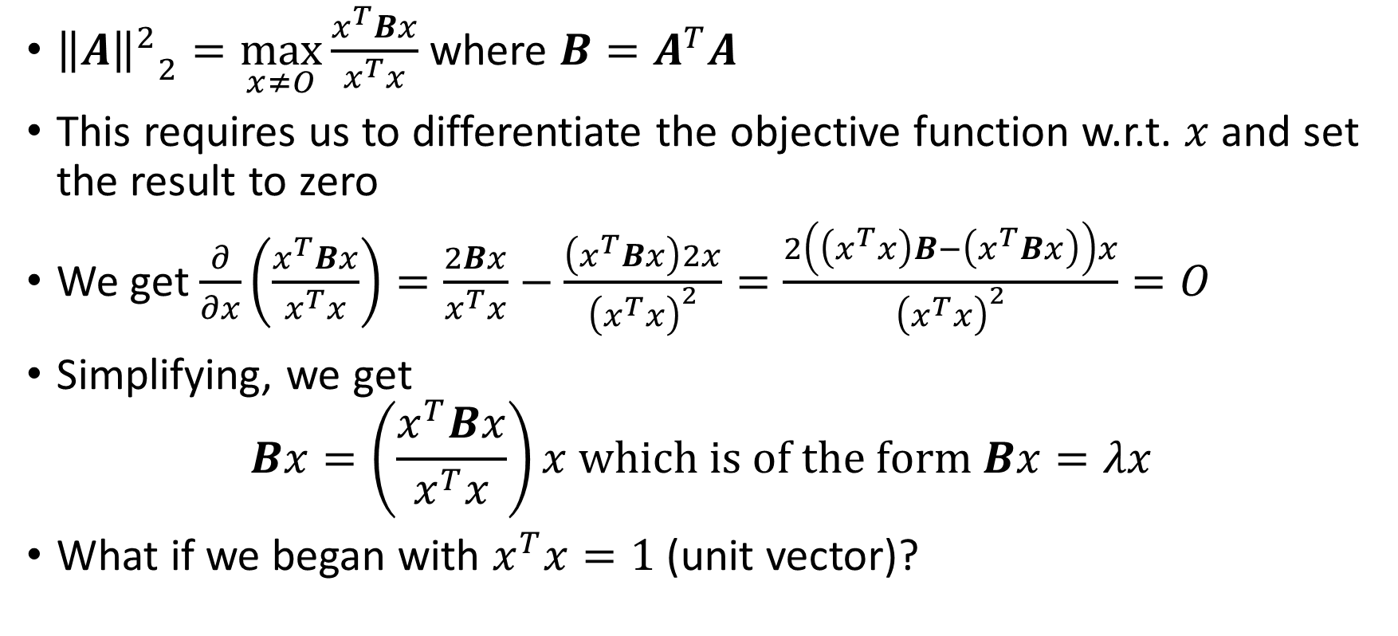
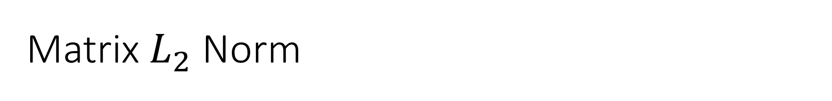
Matrix $L_{2}$ Norm
${{\left\|A\right\|}^{2}}_{2}=\max_{x≠O}{\frac{x^{T}Bx}{x^{T}x}}$ where $B=A^{T}A$
This requires us to differentiate the objective function w.r.t. $x$ and set the result to zero
We get $\frac{∂}{∂x}\left(\frac{x^{T}Bx}{x^{T}x}\right)=\frac{2Bx}{x^{T}x}−\frac{\left(x^{T}Bx\right)2x}{{\left(x^{T}x\right)}^{2}}=\frac{2\left(\left(x^{T}x\right)B−\left(x^{T}Bx\right)\right)x}{{\left(x^{T}x\right)}^{2}}=O$
Simplifying, we get
$$Bx=\left(\frac{x^{T}Bx}{x^{T}x}\right)x which is of the form Bx=λx$$
What if we began with $x^{T}x=1$ (unit vector)?

Slide 3
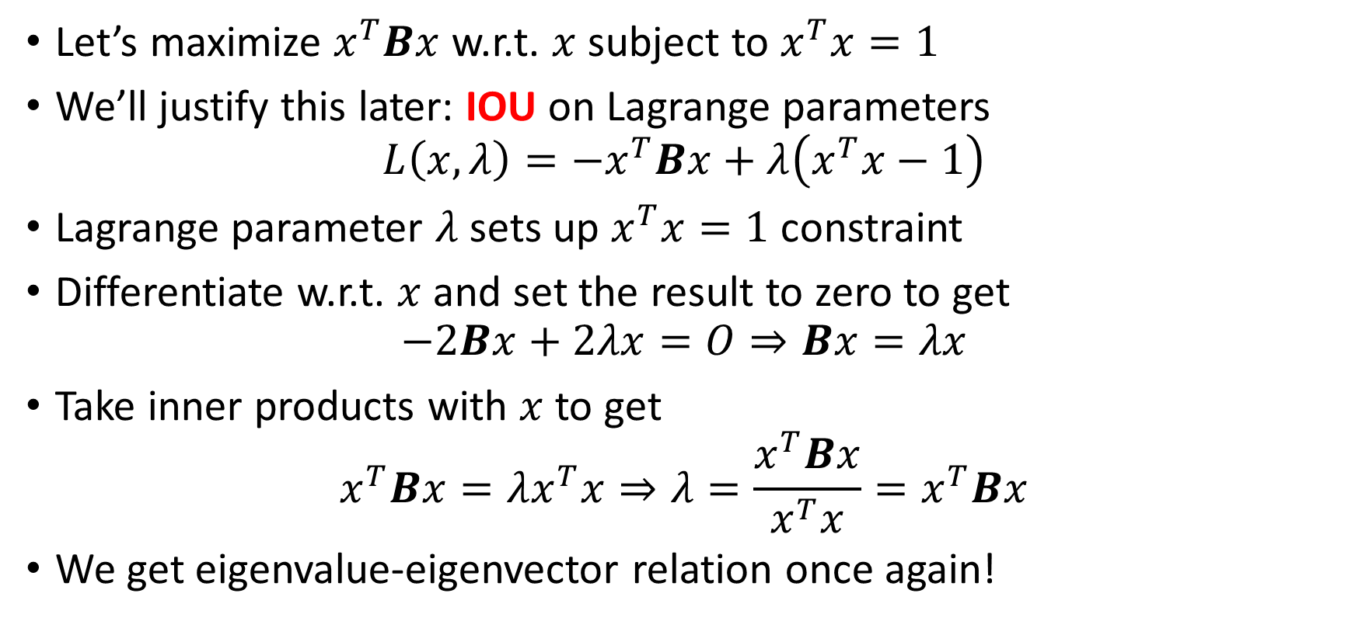
An alternative approach: Lagrange parameters
Let’s maximize $x^{T}Bx$ w.r.t. $x$ subject to $x^{T}x=1$
We’ll justify this later: IOU on Lagrange parameters
$$L\left(x,λ\right)=−x^{T}Bx+λ\left(x^{T}x−1\right)$$
Lagrange parameter $λ$ sets up $x^{T}x=1$ constraint
Differentiate w.r.t. $x$ and set the result to zero to get
$$−2Bx+2λx=O⇒Bx=λx$$
Take inner products with $x$ to get
$$x^{T}Bx=λx^{T}x⇒λ=\frac{x^{T}Bx}{x^{T}x}=x^{T}Bx$$
We get eigenvalue-eigenvector relation once again!

Slide 4
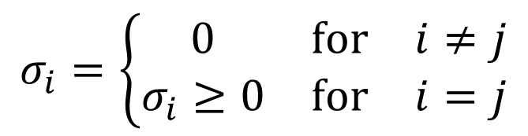
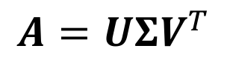
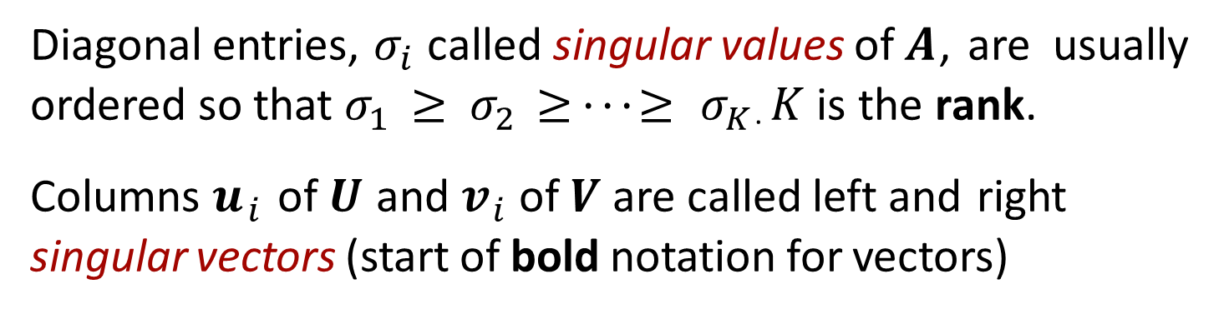
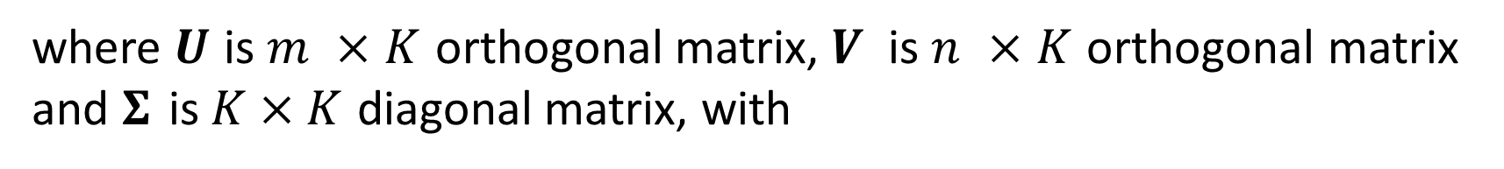
Singular Value Decomposition
Singular value decomposition (SVD) of $m × n$matrix $A$ has form
$$A=UΣV^{T}$$
where $U$ is $m ×K$ orthogonal matrix, $V$ is $n ×K$ orthogonal matrix and $Σ$ is $K×K$ diagonal matrix, with
$$σ_{i}=\left\{\begin{matrix}0 & for & i≠j \\ σ_{i}≥0 & for & i=j\end{matrix}\right.$$
Diagonal entries, $σ_{i}$ called singular values of $A$, are usually ordered so that $σ_{1} ≥ σ_{2} ≥ · · · ≥ σ_{K}$. $K$ is the rank.
Columns $u_{i}$ of $U$ and $v_{i}$ of $V$ are called left and right
singular vectors (start of bold notation for vectors)

Slide 5
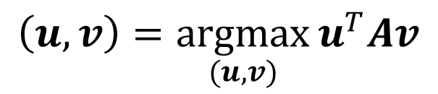
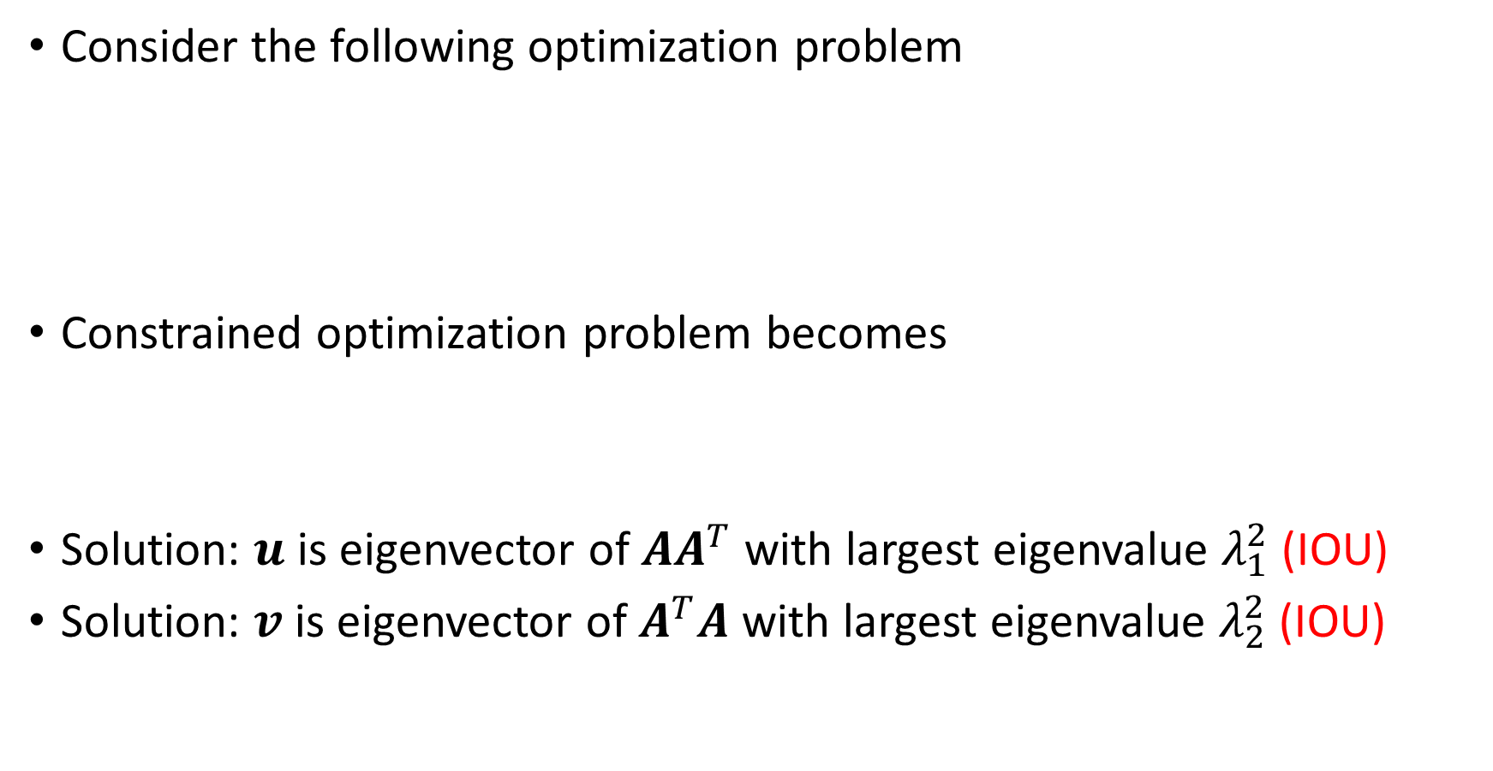
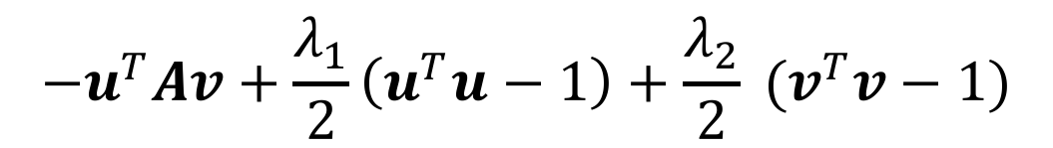
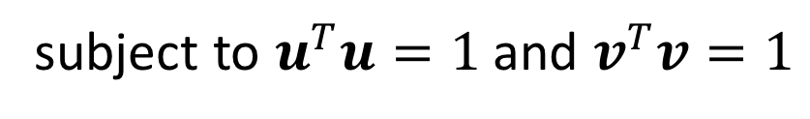
The SVD from a maximization principle
Consider the following optimization problem
Constrained optimization problem becomes
Solution: $u$ is eigenvector of $AA^{T}$ with largest eigenvalue $λ_{1}^{2}$ (IOU)
Solution: $v$ is eigenvector of $A^{T}A$ with largest eigenvalue $λ_{2}^{2}$ (IOU)
$$\left(u,v\right)=\underset{(u,v)}{argmax}{u^{T}Av}$$
subject to $u^{T}u=1$ and $v^{T}v=1$
$$−u^{T}Av+\frac{λ_{1}}{2}\left(u^{T}u−1\right)+\frac{λ_{2}}{2} (v^{T}v−1)$$
$${σ_{1}=u}^{T}Av=v^{T}A^{T}Av/λ_{1}=u^{T}AA^{T}u/λ_{2}$$

Slide 6
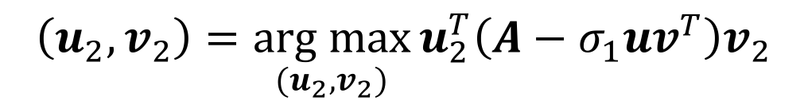
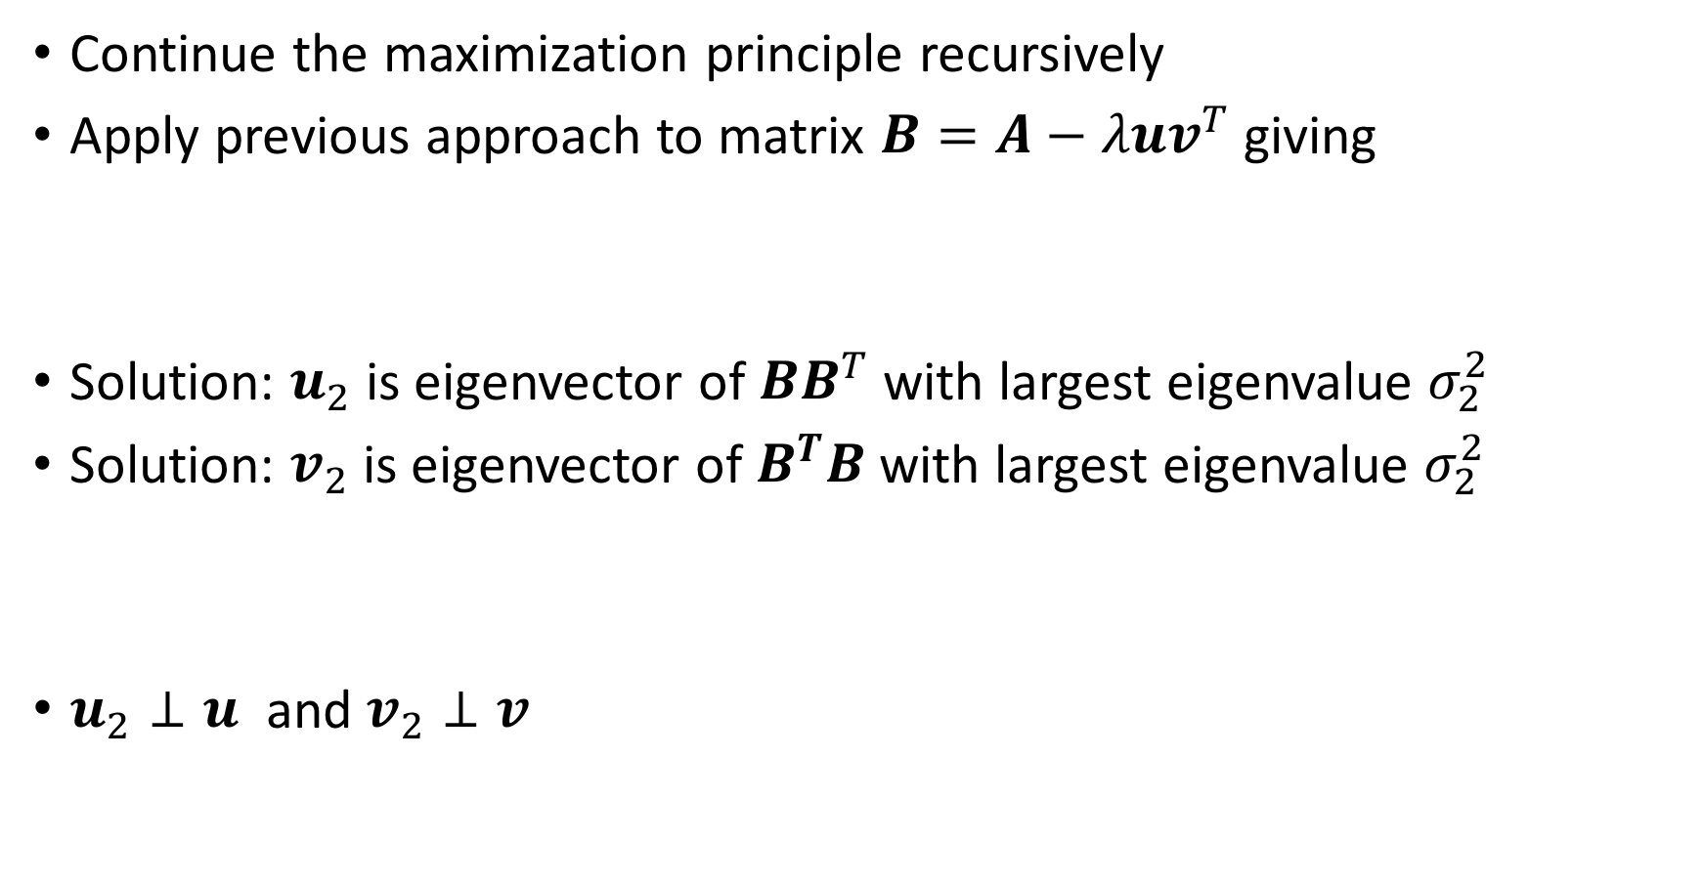
The SVD from a maximization principle (contd.)
Continue the maximization principle recursively
Apply previous approach to matrix $B=A−λuv^{T}$ giving
Solution: $u_{2}$ is eigenvector of $BB^{T}$ with largest eigenvalue $σ_{2}^{2}$
Solution: $v_{2}$ is eigenvector of $B^{T}B$ with largest eigenvalue $σ_{2}^{2}$
$u_{2}⊥u$ and $v_{2}⊥v$
$$\left(u_{2},v_{2}\right)=\underset{(u_{2},v_{2})}{arg max}{u_{2}^{T}\left(A−σ_{1}uv^{T}\right)v_{2}}$$
$${σ_{2}=u}_{2}^{T}Bv_{2}=v_{2}^{T}B^{T}Bv_{2}/σ_{2}=u_{2}^{T}BB^{T}u_{2}/σ_{2}$$

Slide 7
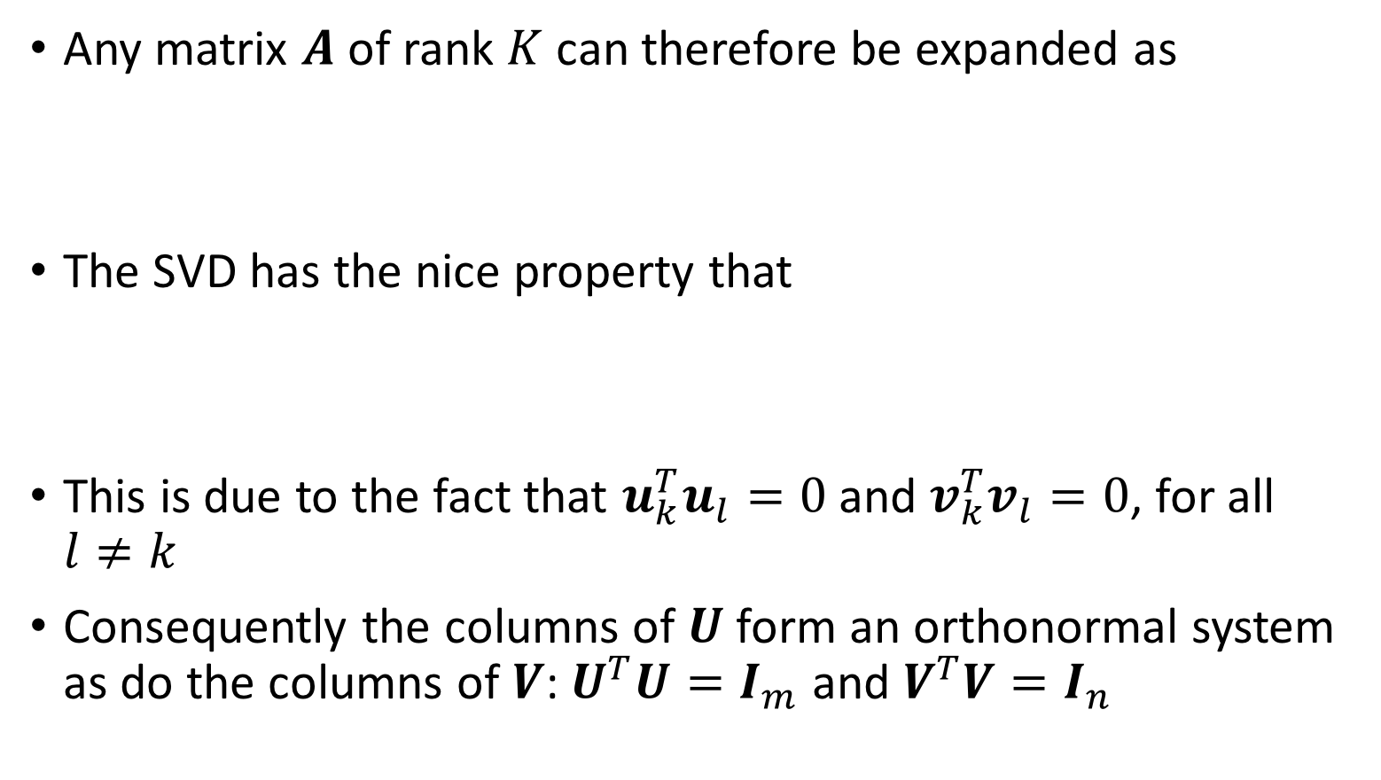
The SVD expansion
Any matrix $A$ of rank $K$ can therefore be expanded as
The SVD has the nice property that
This is due to the fact that $u_{k}^{T}u_{l}=0$ and $v_{k}^{T}v_{l}=0$, for all $l≠k$
Consequently the columns of $U$ form an orthonormal system as do the columns of $V$: $U^{T}U=I_{m}$ and $V^{T}V=I_{n}$
$$A=σ_{1}u_{1}v_{1}^{T}+σ_{2}u_{2}v_{2}^{T}+⋯+σ_{K}u_{K}v_{K}^{T}=UΣV^{T}$$
$$u_{k}^{T}Av_{k}=u_{k}^{T}\left(σ_{1}u_{1}v_{1}^{T}+σ_{2}u_{2}v_{2}^{T}+⋯+σ_{K}u_{K}v_{K}^{T} \right)v_{k}=σ_{k}$$

Slide 8
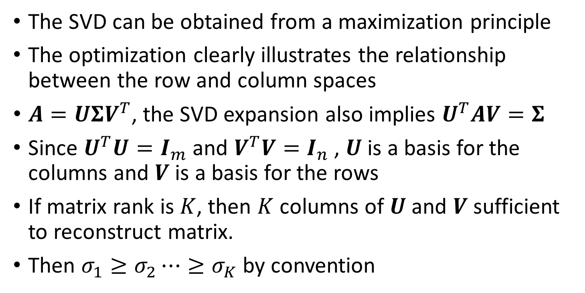
Conclusions
The SVD can be obtained from a maximization principle
The optimization clearly illustrates the relationship between the row and column spaces
$A=UΣV^{T}$, the SVD expansion also implies $U^{T}AV=Σ$
Since $U^{T}U=I_{m}$ and $V^{T}V=I_{n}$ , $U$ is a basis for the columns and $V$ is a basis for the rows
If matrix rank is $K$, then $K$ columns of $U$ and $V$ sufficient to reconstruct matrix.
Then $σ_{1}≥σ_{2}⋯≥σ_{K}$ by convention

Slide 9

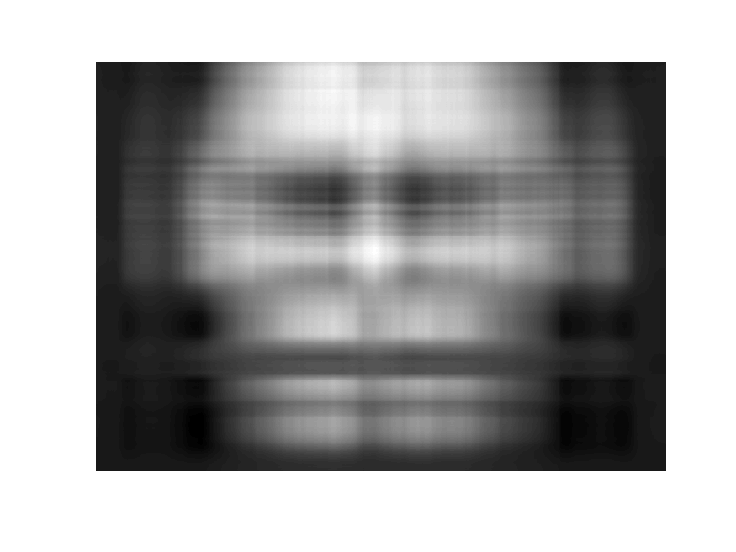
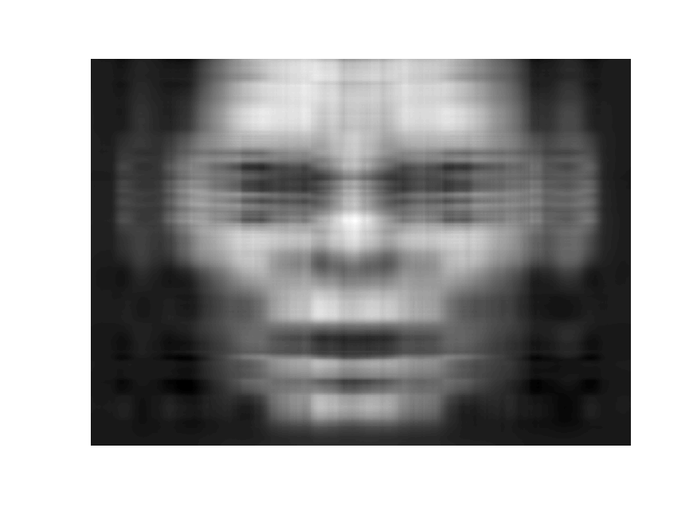
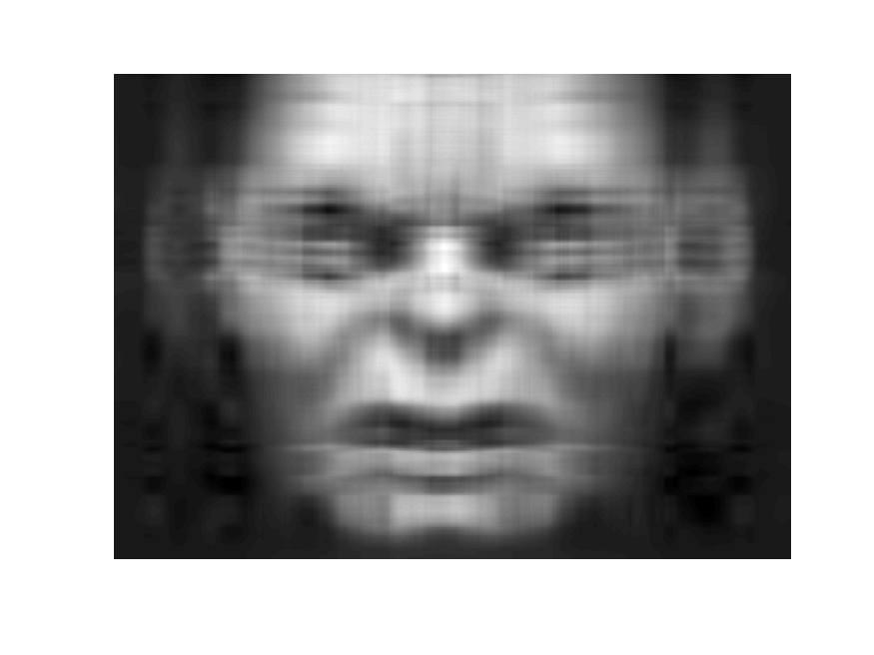



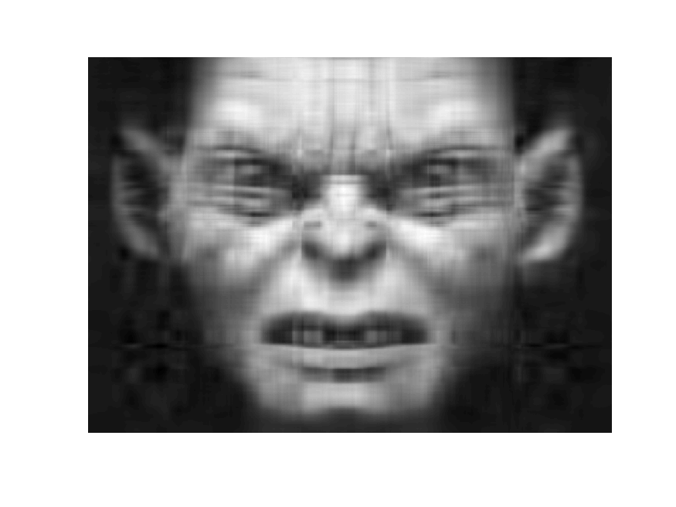




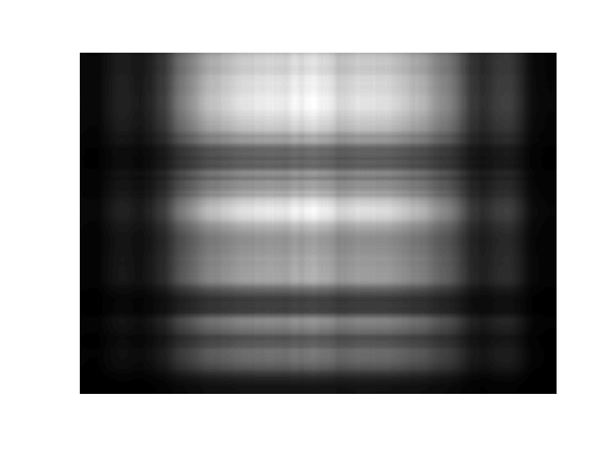
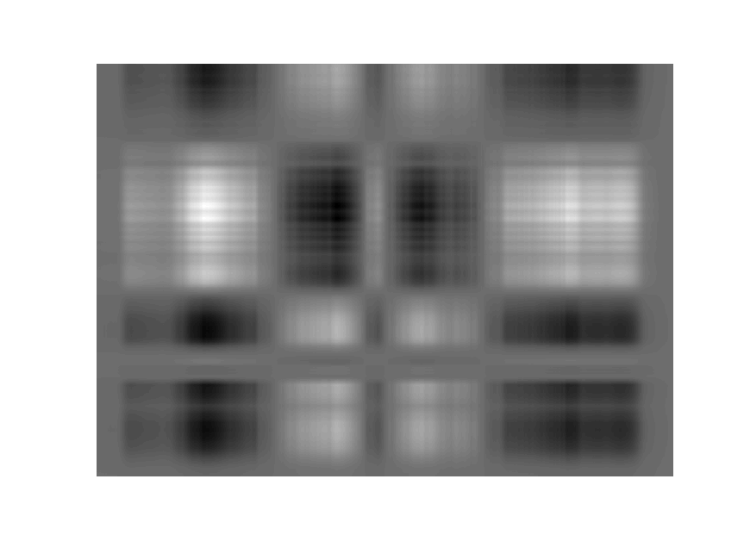
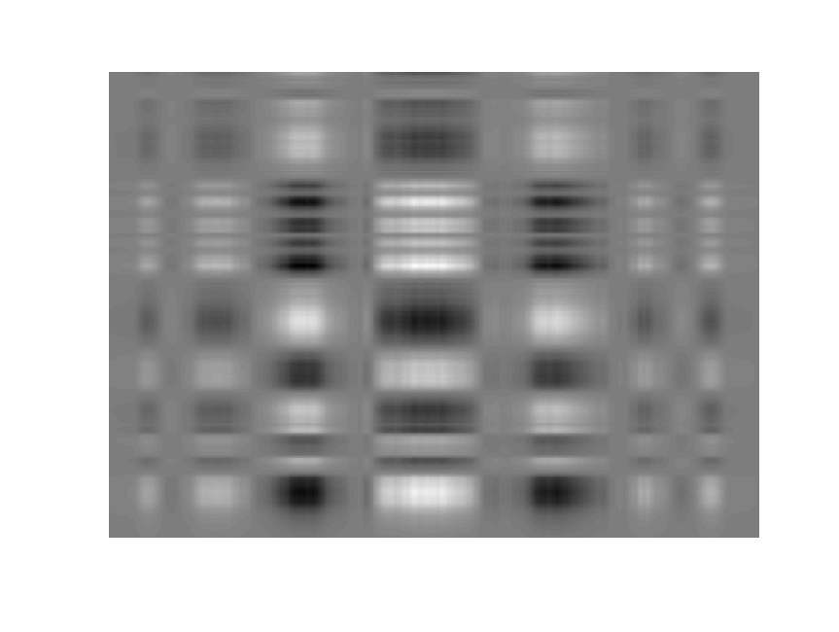
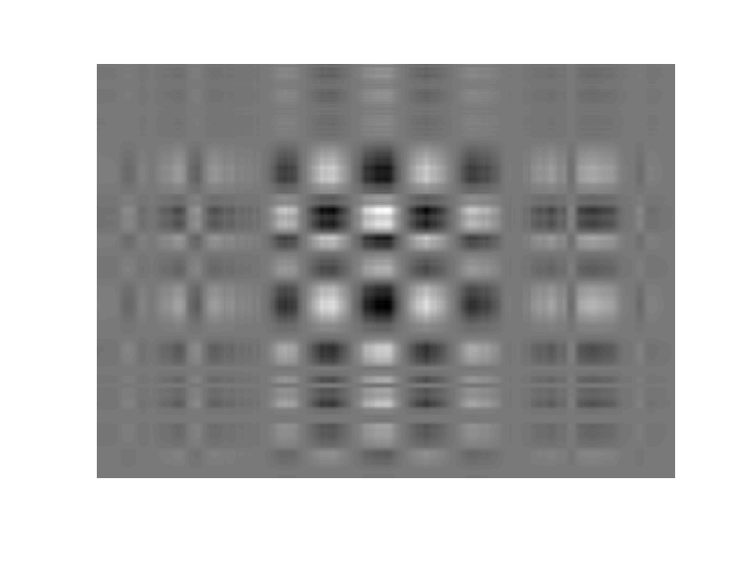
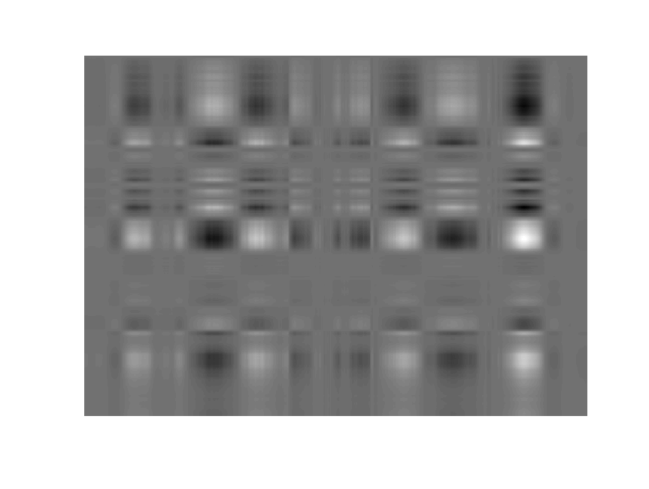
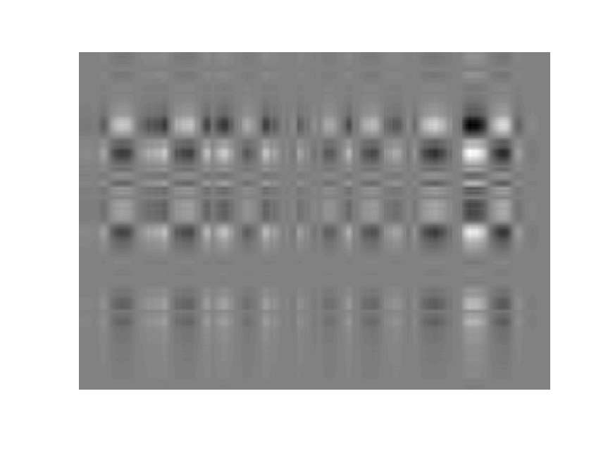
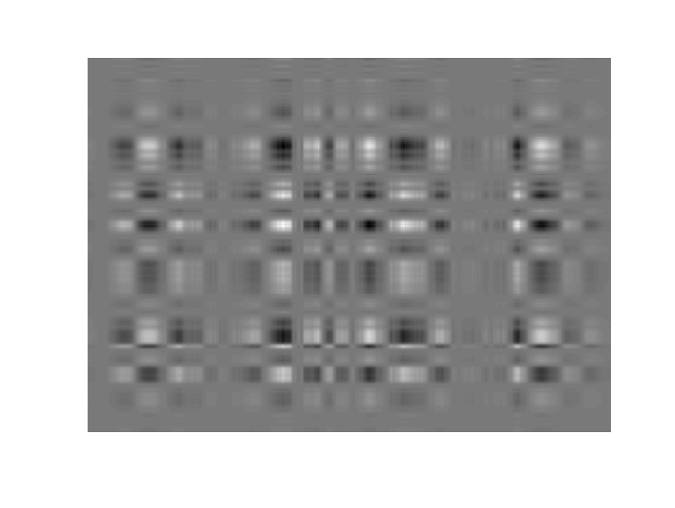
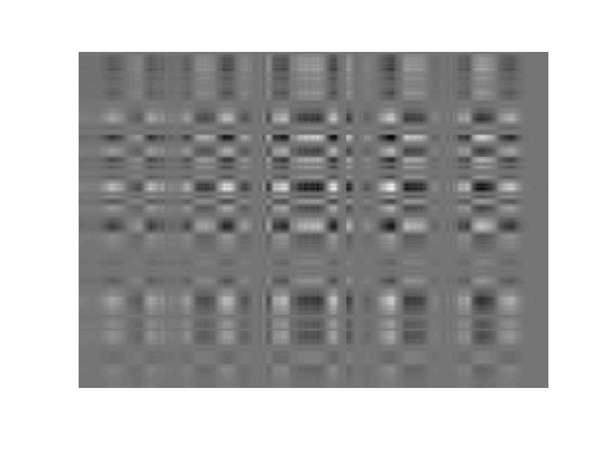
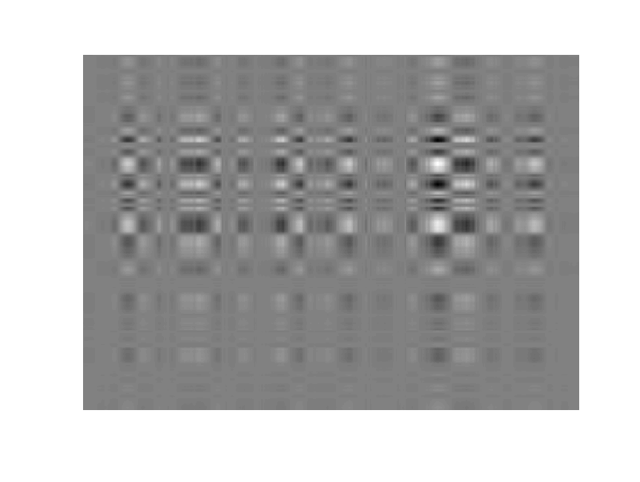
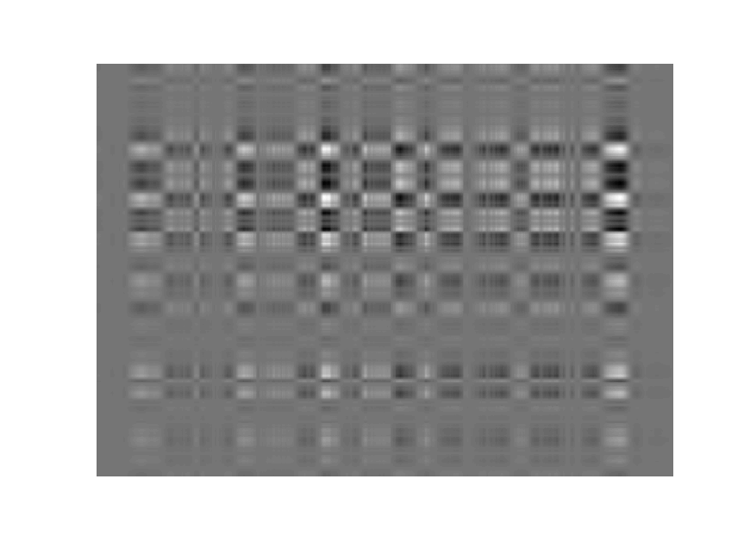
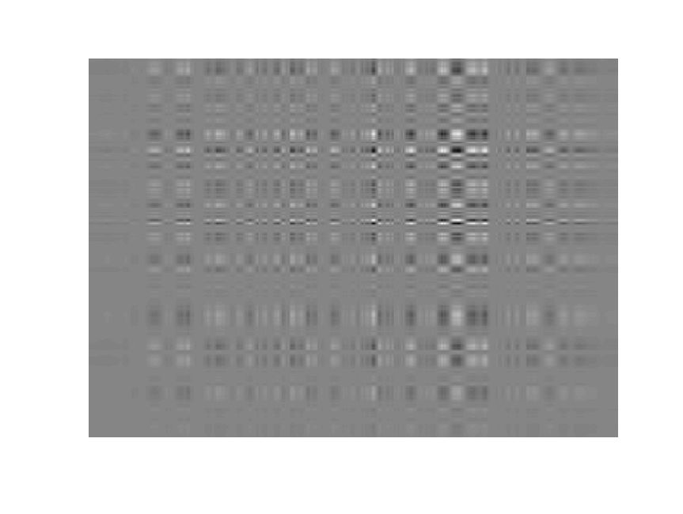

1
8
2
3
0
4
20
5
6
7
10
100
9

Slide 10
Logarithm of
singular value

Slide 11
Reconstruction Error Plot

Slide 12

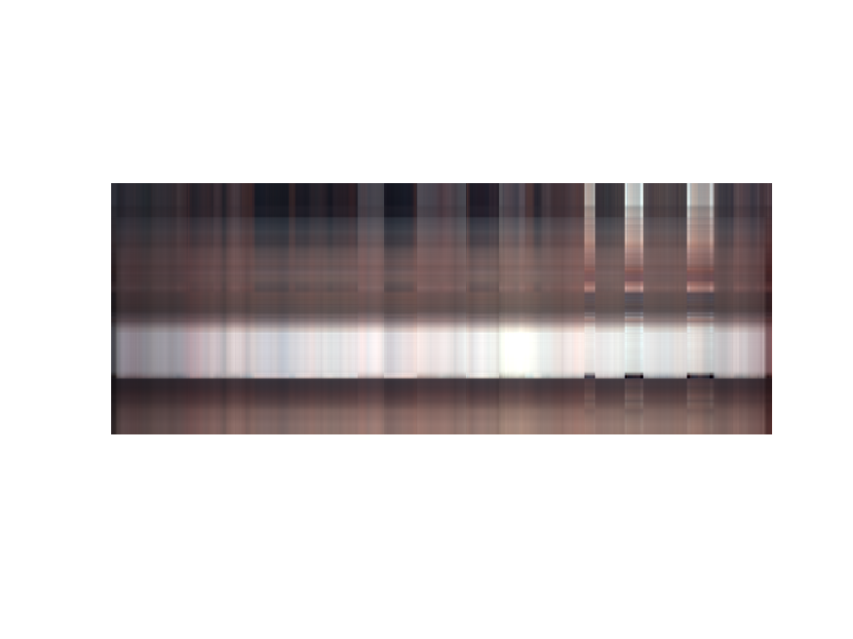

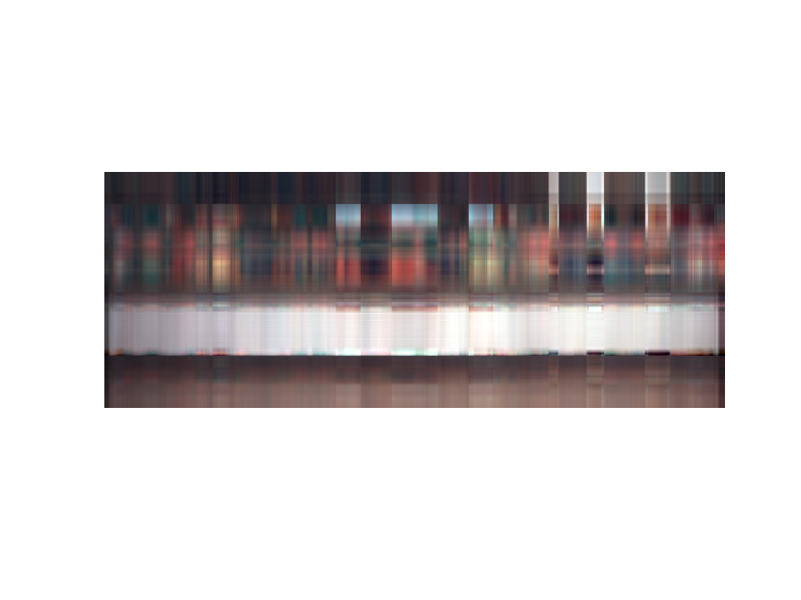
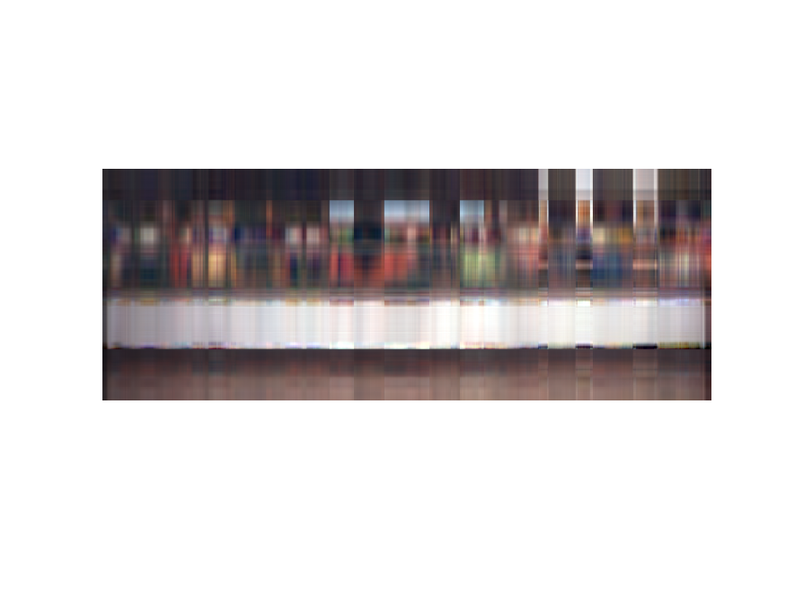
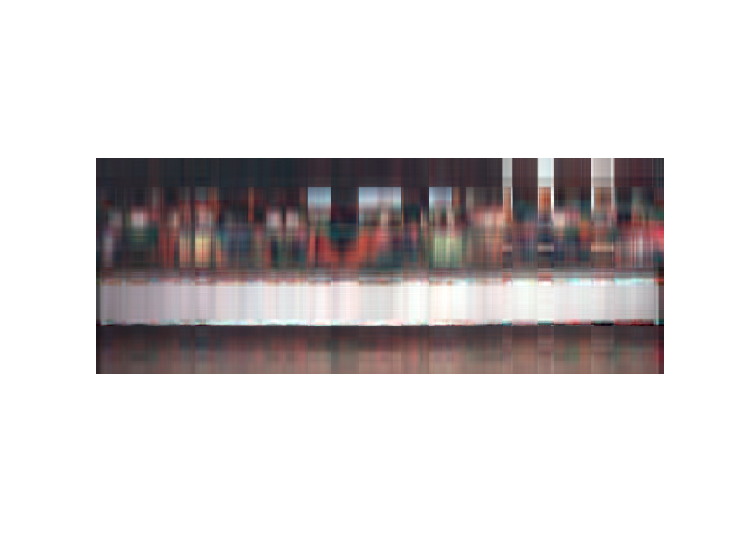
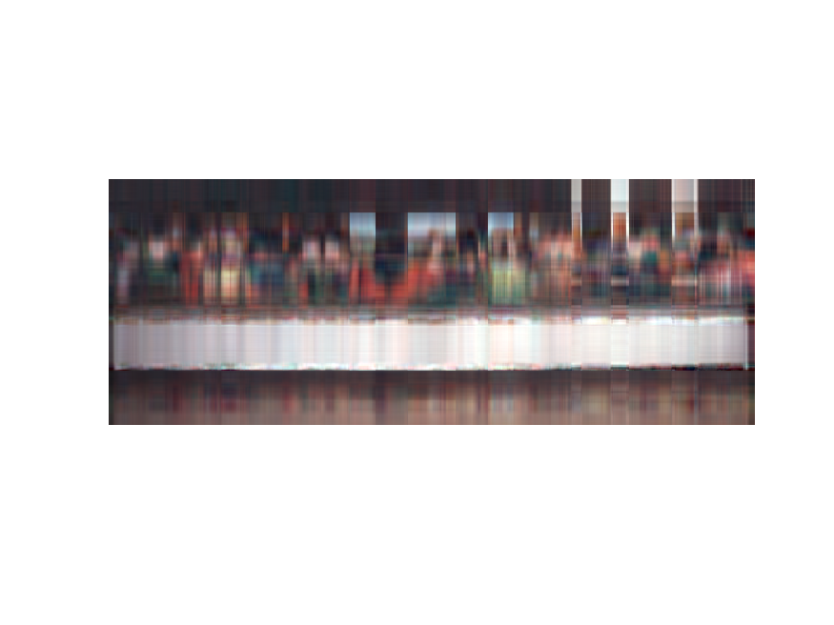
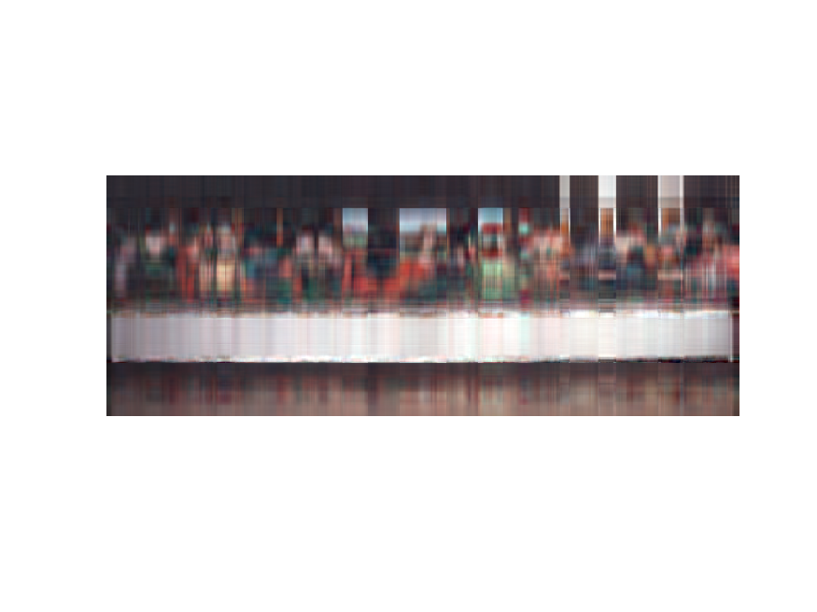
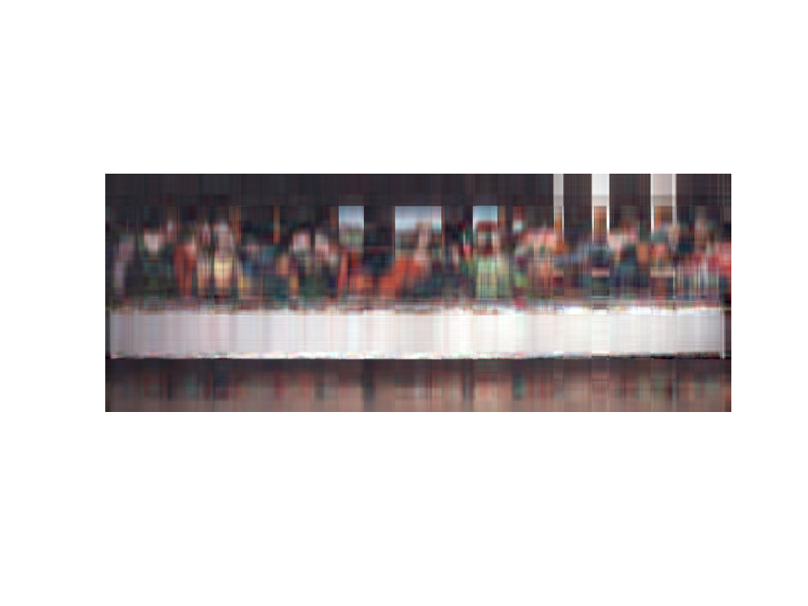
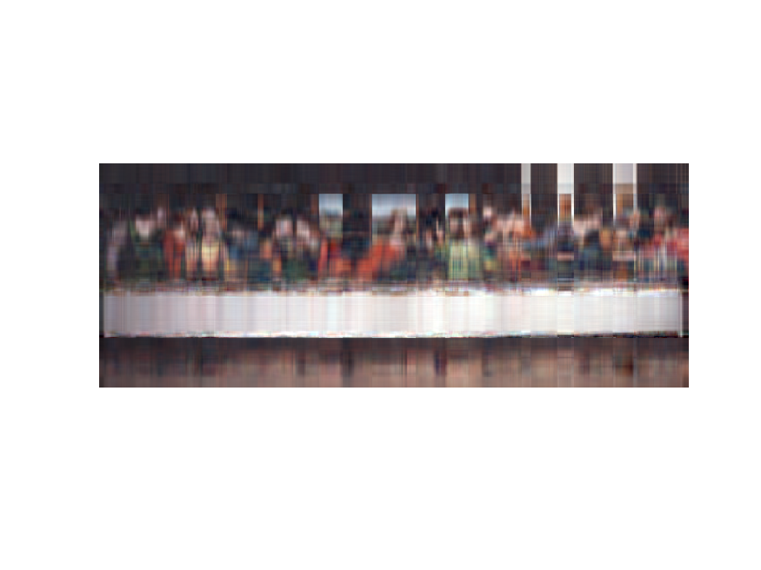

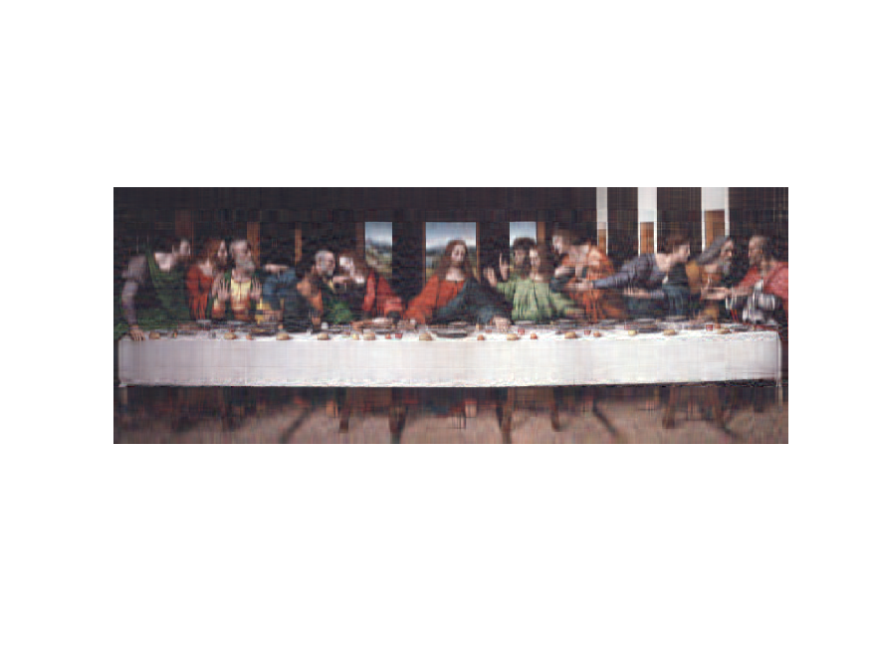


100
200
10
30
20
7
9
6
8
1
2
3
4
5

